Slide 1
Tillage

Slide 2
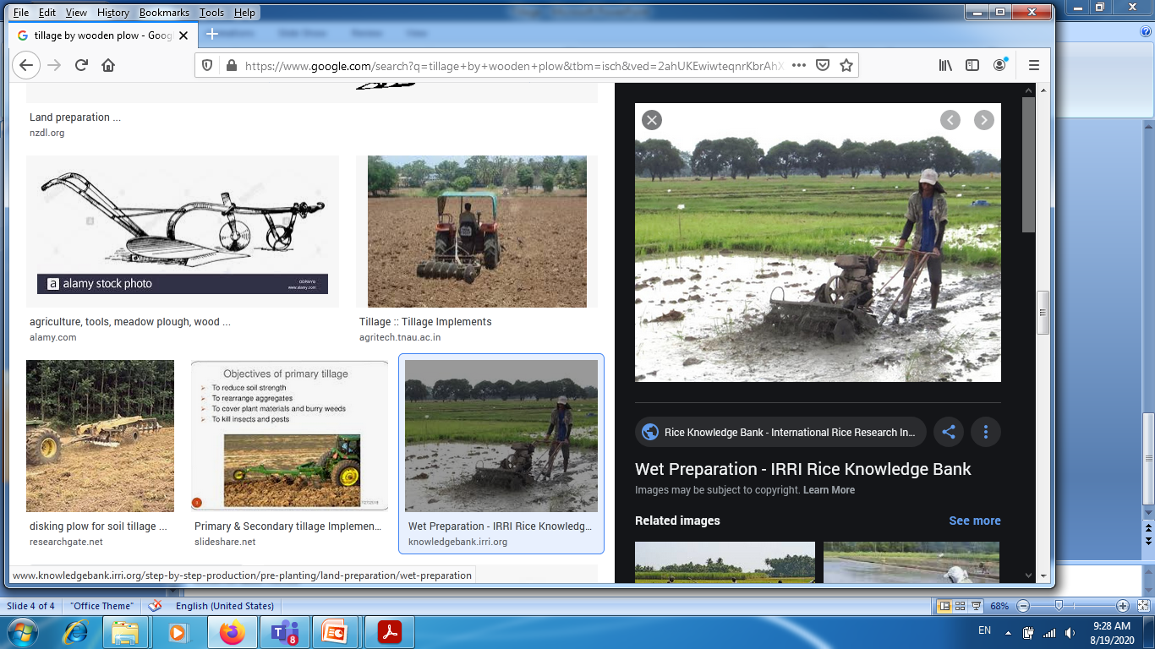
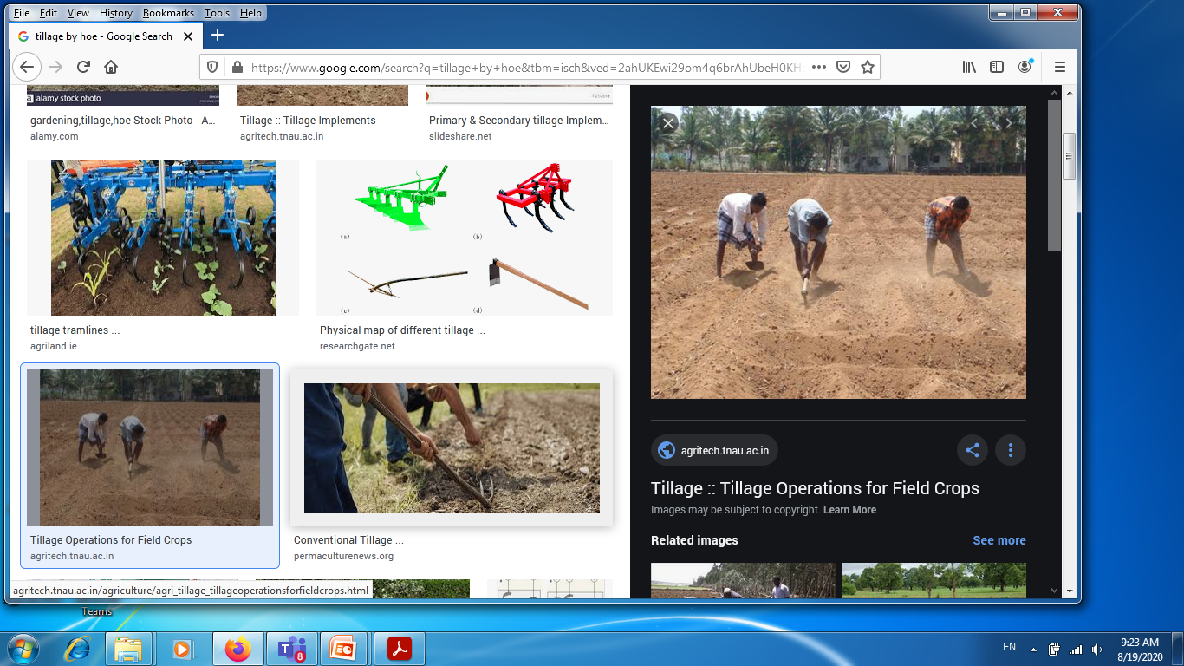
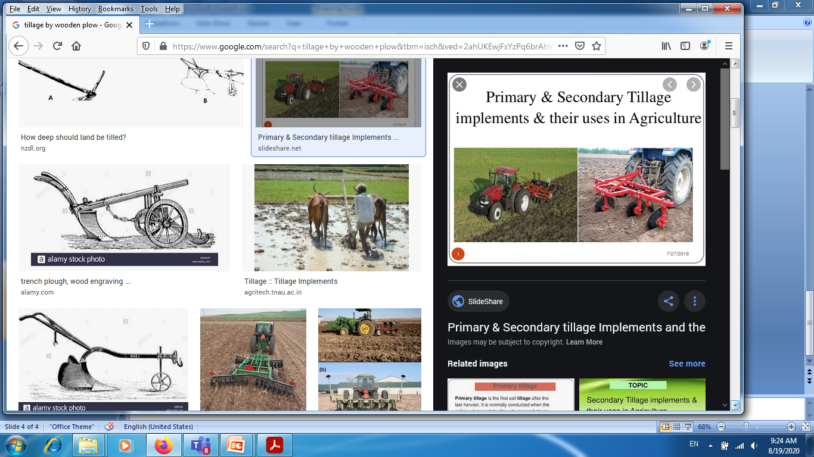
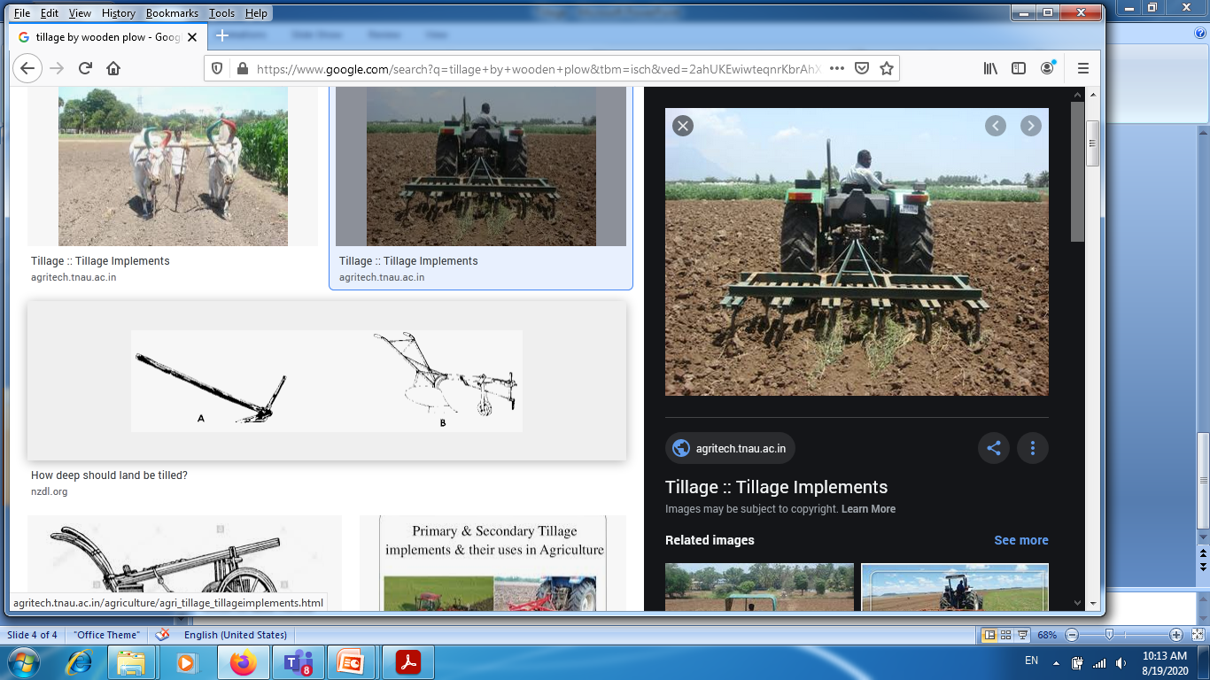

Slide 3
What is tillage?
Tillage is basic operation of the soil for the crop cultivation.
Tillage is the manipulation of soil to obtain favorable conditions for the germinations of seeds, plant establishment and growth.
Tillage operation includes; Digging, plowing, harrowing, mechanical destruction of weeds and soil crust etc.

Slide 4
Objectives of tillage
To prepare a seedbed of a good tilth
To destroy weeds and prevent its growth
To incorporate organic mater, manure and fertilizer in soil
To improve aeration in the soil
To improve infiltration and water retaining capacity of soil and reduce water losses
Precision leveling

Slide 5
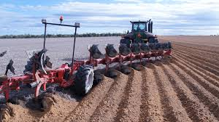
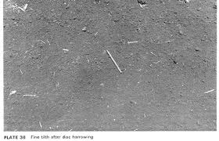

Slide 6
Types of Tillage
Primary Tillage
Secondary Tillage
Conservation Tillage (resource conservation)

Slide 7
Primary Tillage
Primary tillage is the first soil tillage after the last crop harvest. It is commonly conducted when the soil is wet enough to allow plowing strong enough to give reasonable level of traction. This can be immediately the crop harvest or at the beginning of the next wet season.
Primary tillage tools and implements: Kutto kodalo, Wooden plow, Mould Board (M.B.) plow, Disc plow, in case of Nepal or in south Asia Rotavator and Cultivator

Slide 8
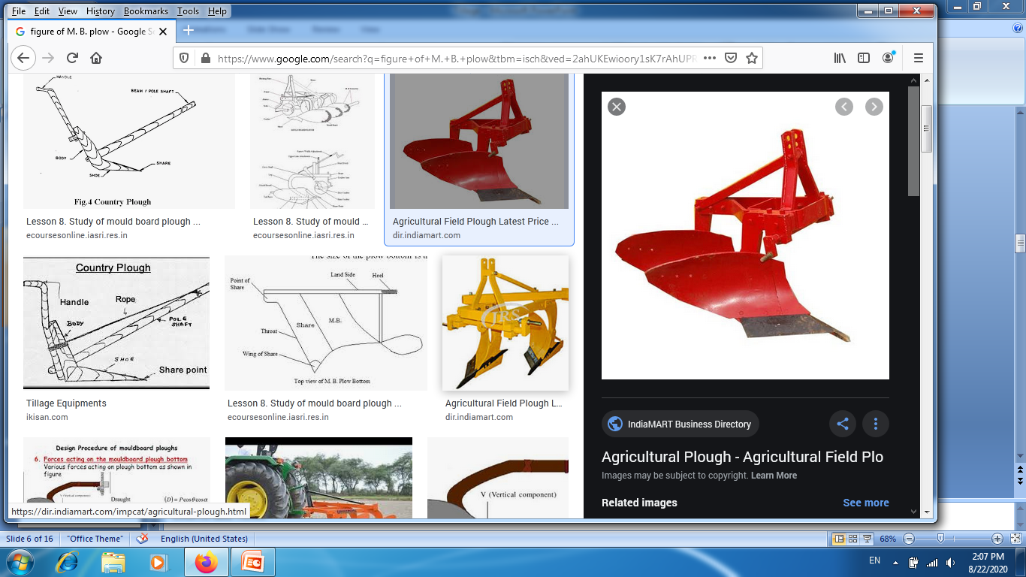
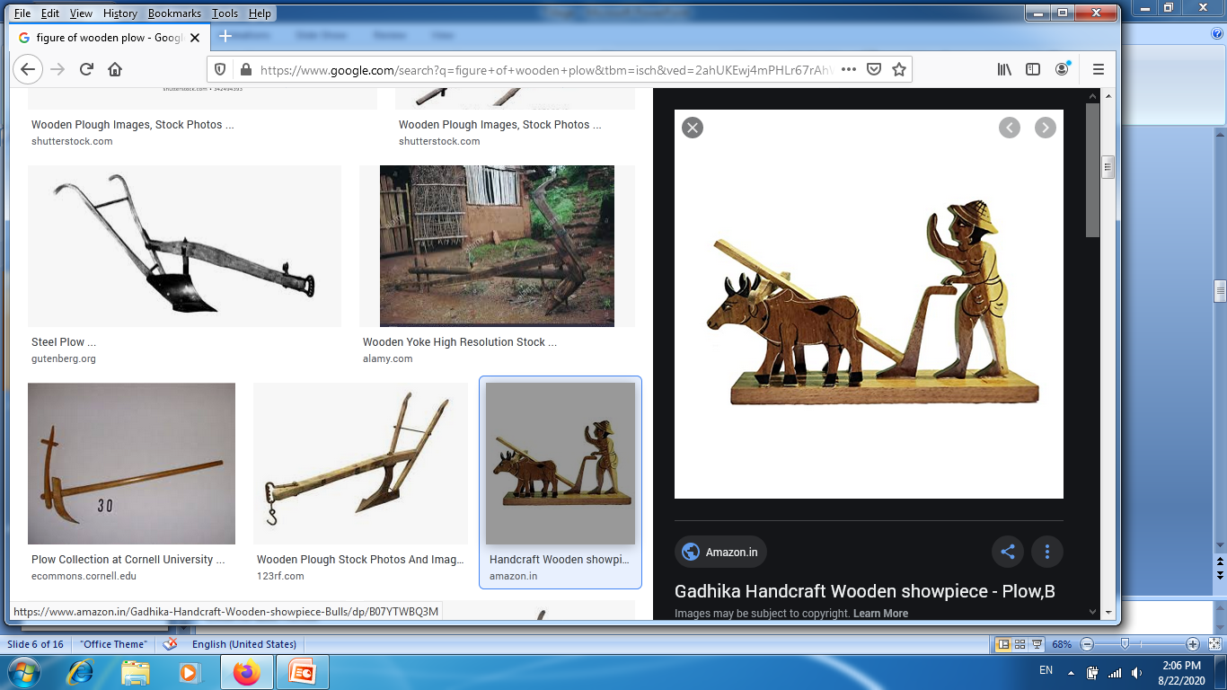
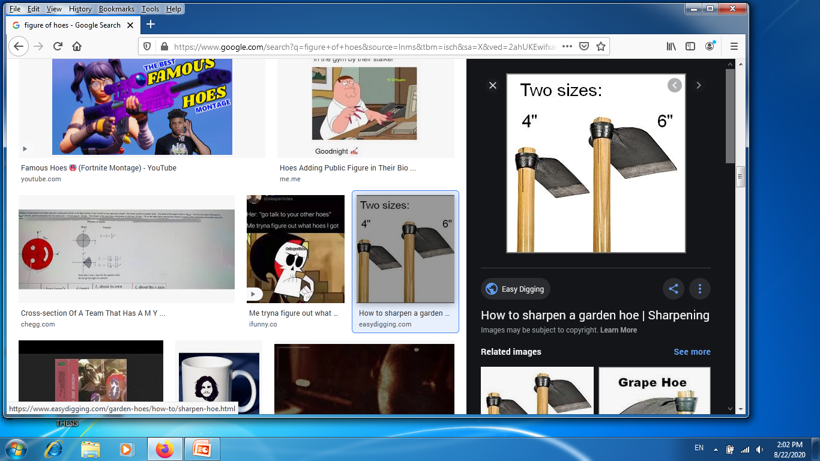
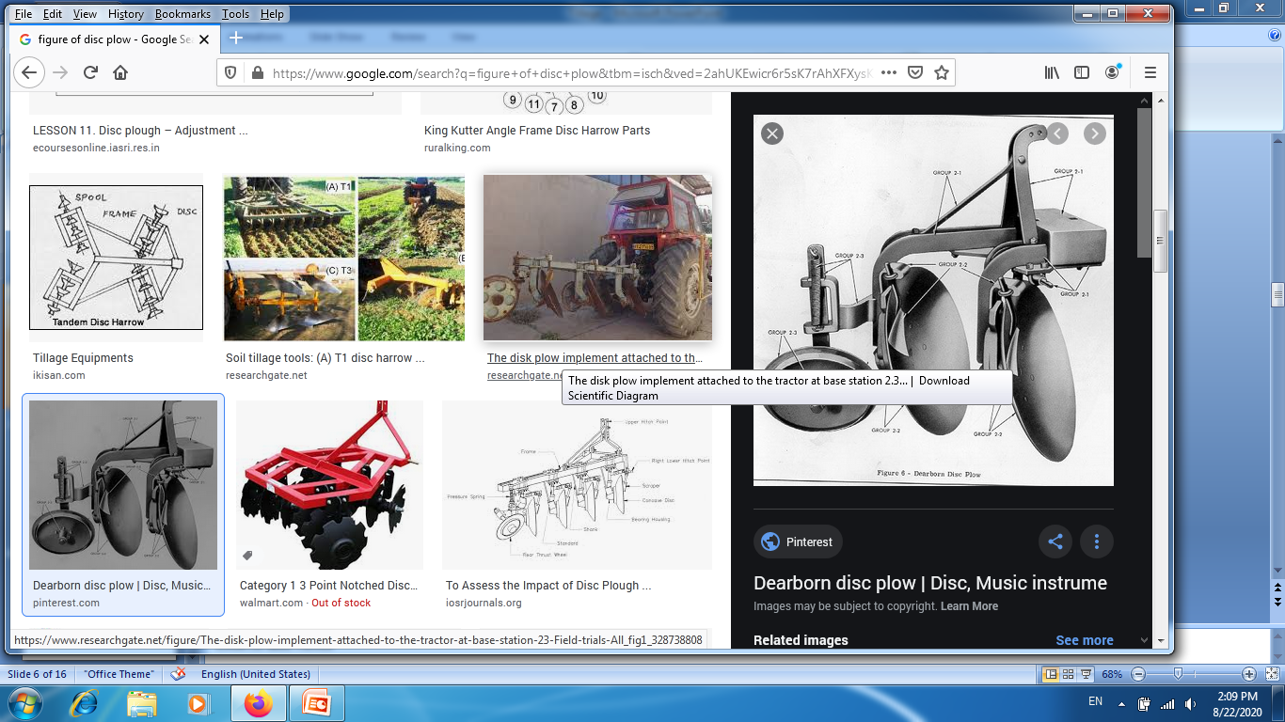

Slide 9
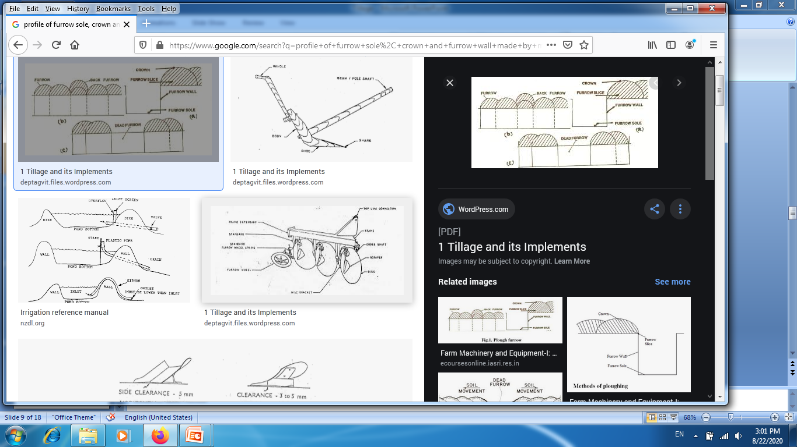

Slide 10
Secondary Tillage
Secondary tillage is used to improve the seedbed by increase soil pulverization to conserve the moisture and nutrients by destructing weeds, and to cut up crop residues, is accomplished by use of various types of harrows, roller or pulverizes, tools for mulching, shapes the rows and preparation of seed bed.
Secondary tillage tools and implements: Hand hoe, Kutto kodalo, wooden plow, Harrow, Cultivator, Rotavator, Planker , Clod crusher and puddler etc.

Slide 11
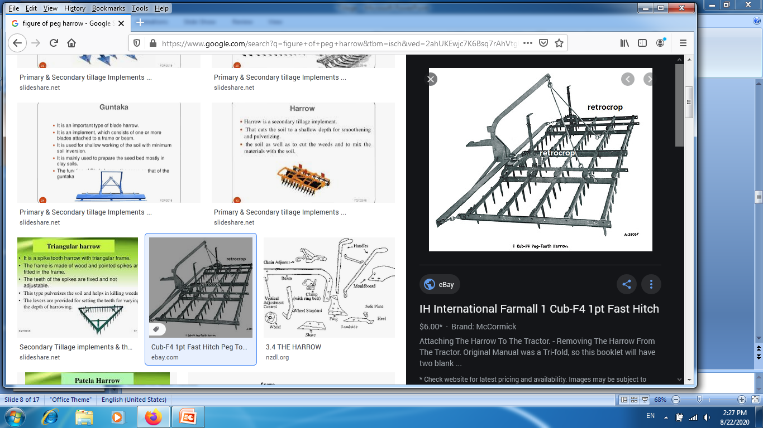
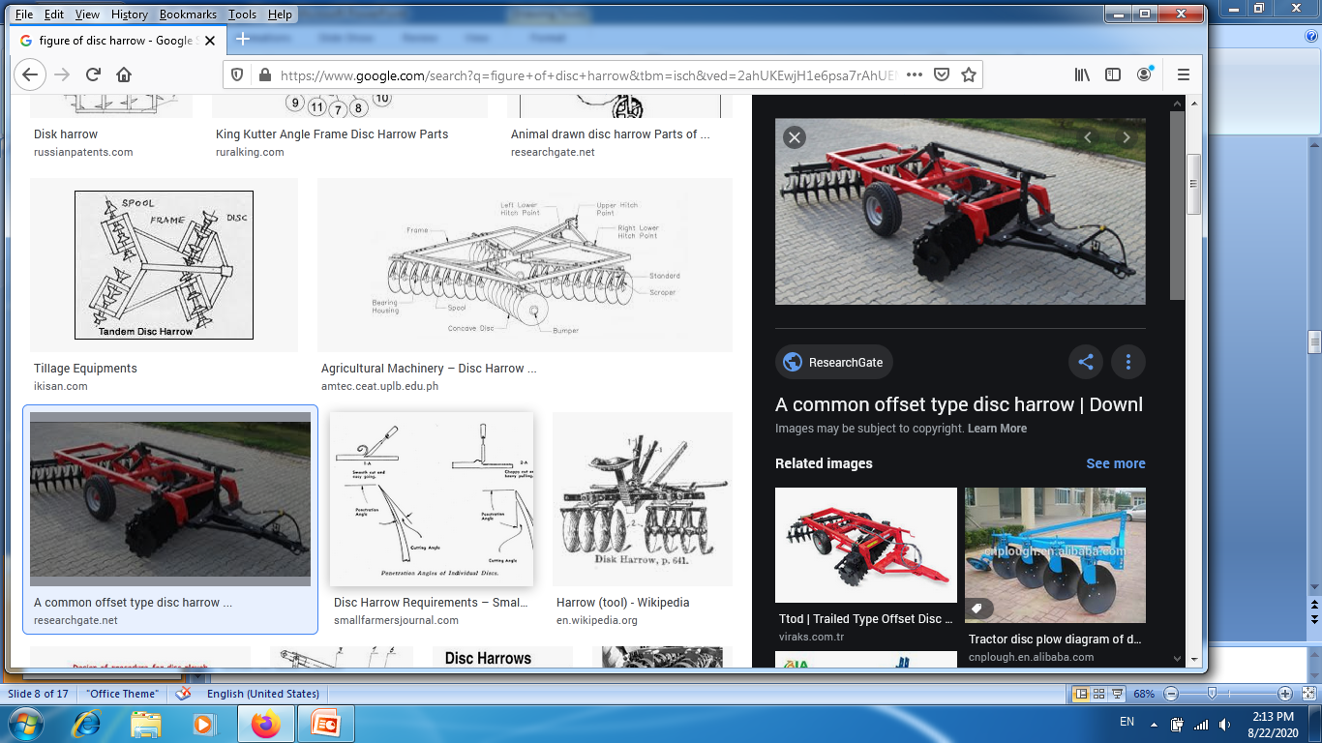
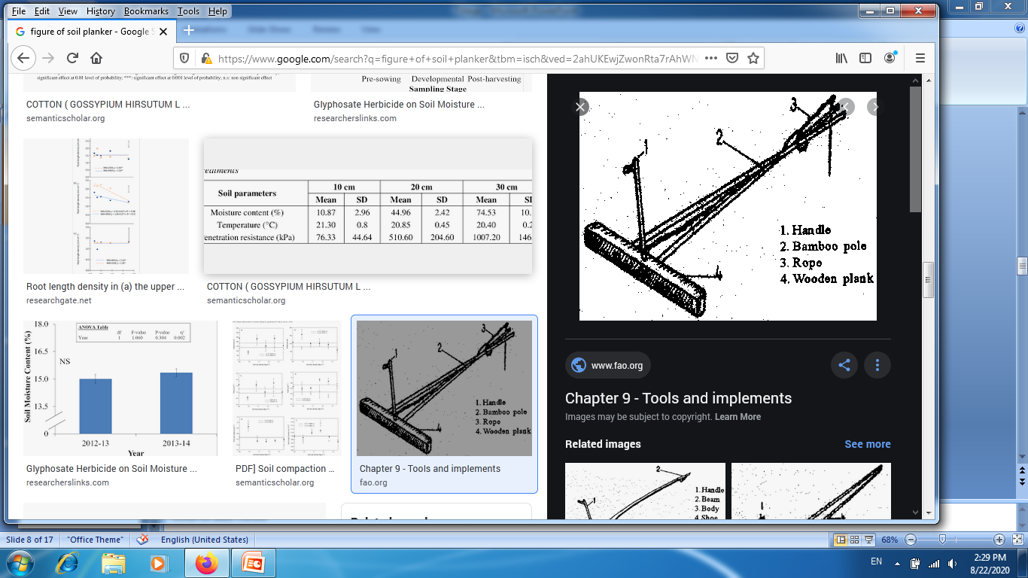
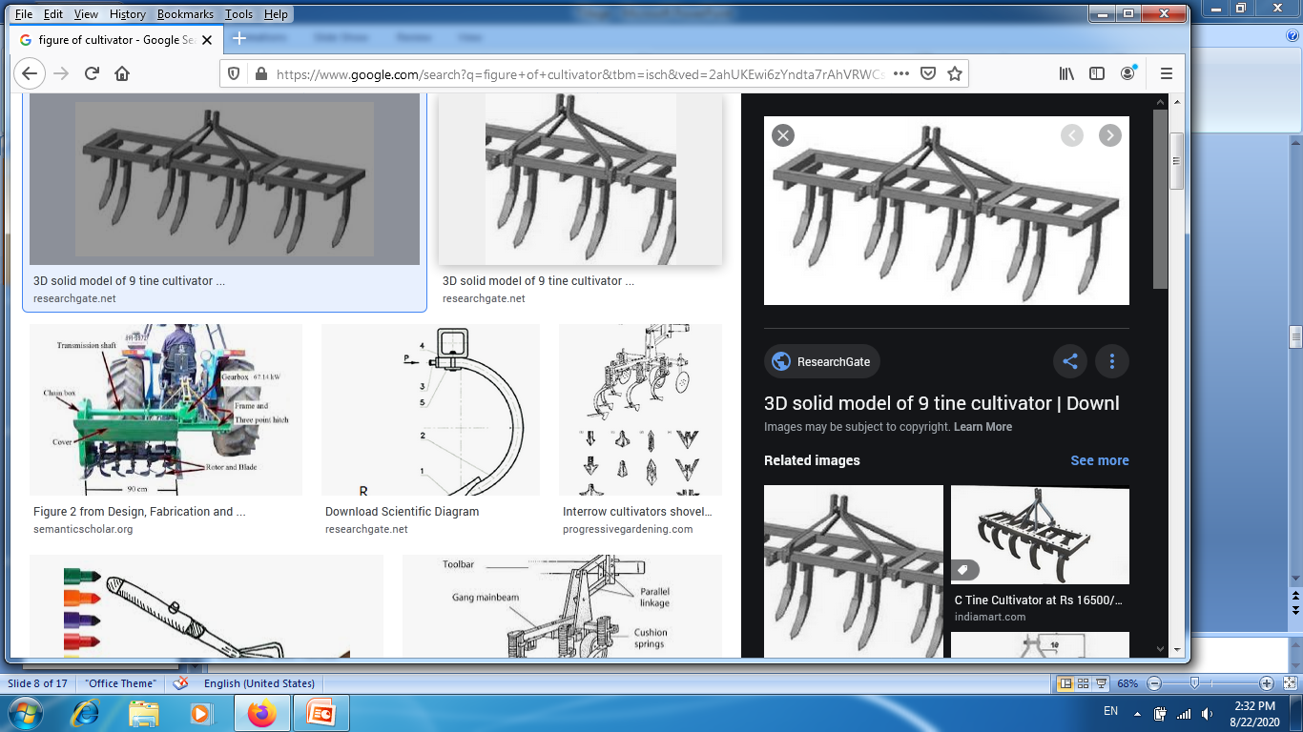

Slide 13
Drawbacks of excessive tillage
Timely planting is not possible due to number of tillage operations
Increase in production cost due to number of passes
Losses of soil moisture due to exposure of moist soil underneath
Losses of soil in rainy seasons mainly in bari land
Destruction of soil structure
Limits water infiltration through surface sealing
Causes tillage erosion
High demand on power, time and equipments

Slide 14
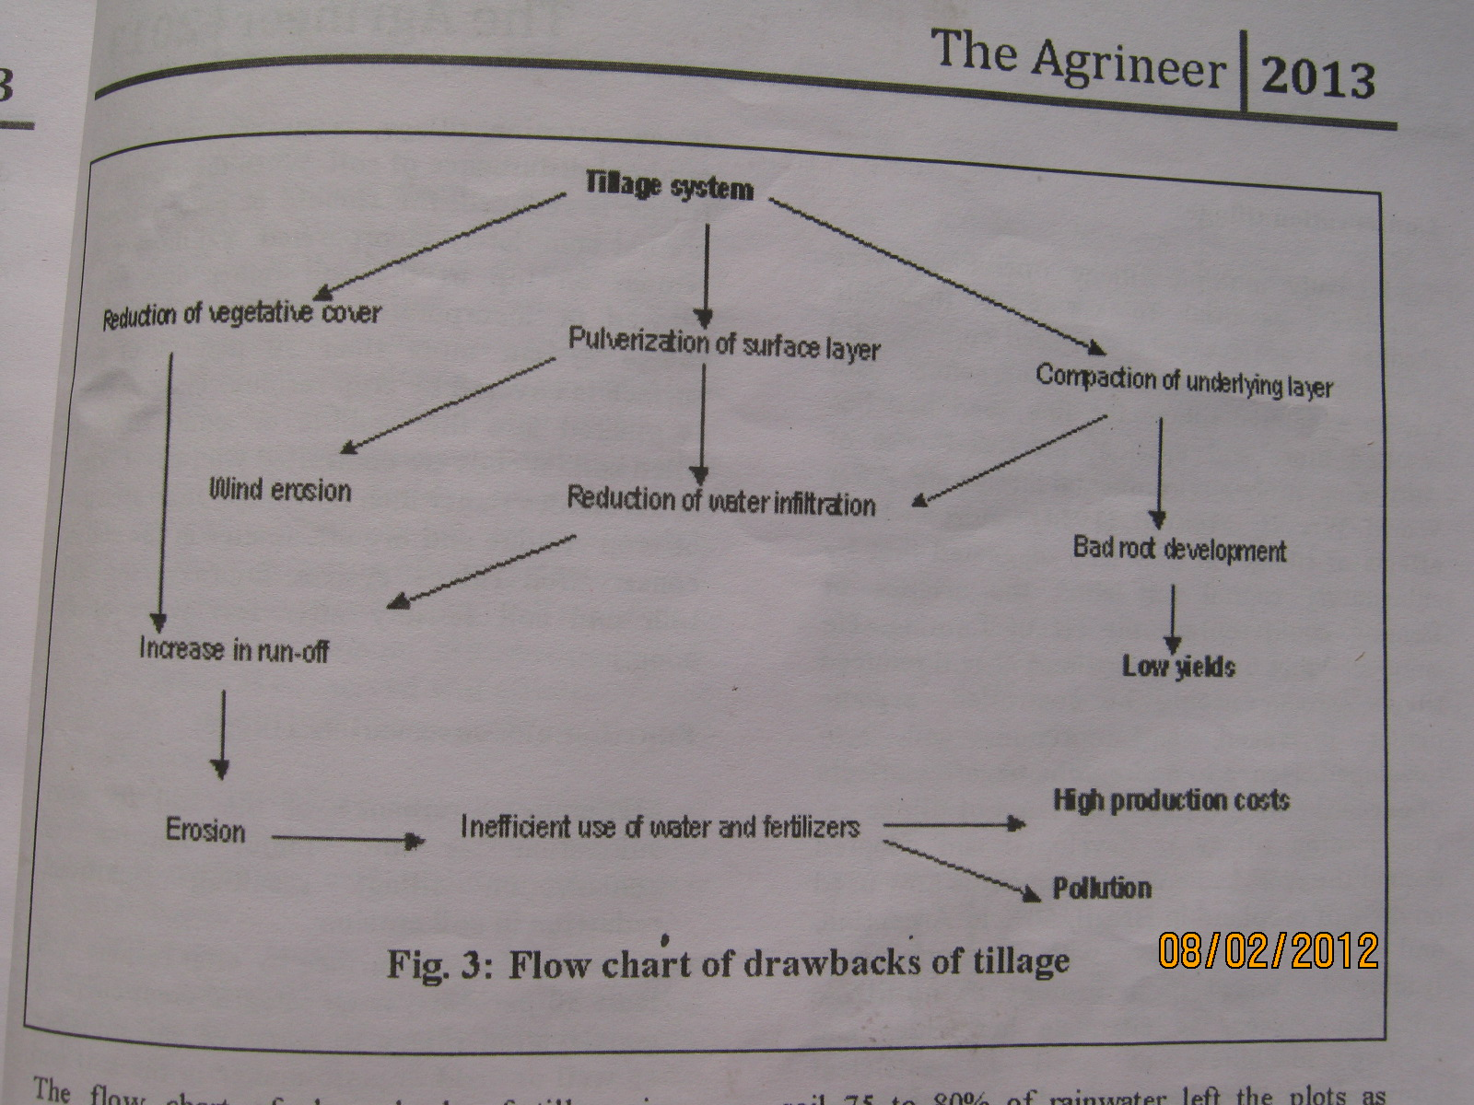
Flow chart of drawbacks of tillage

Slide 15
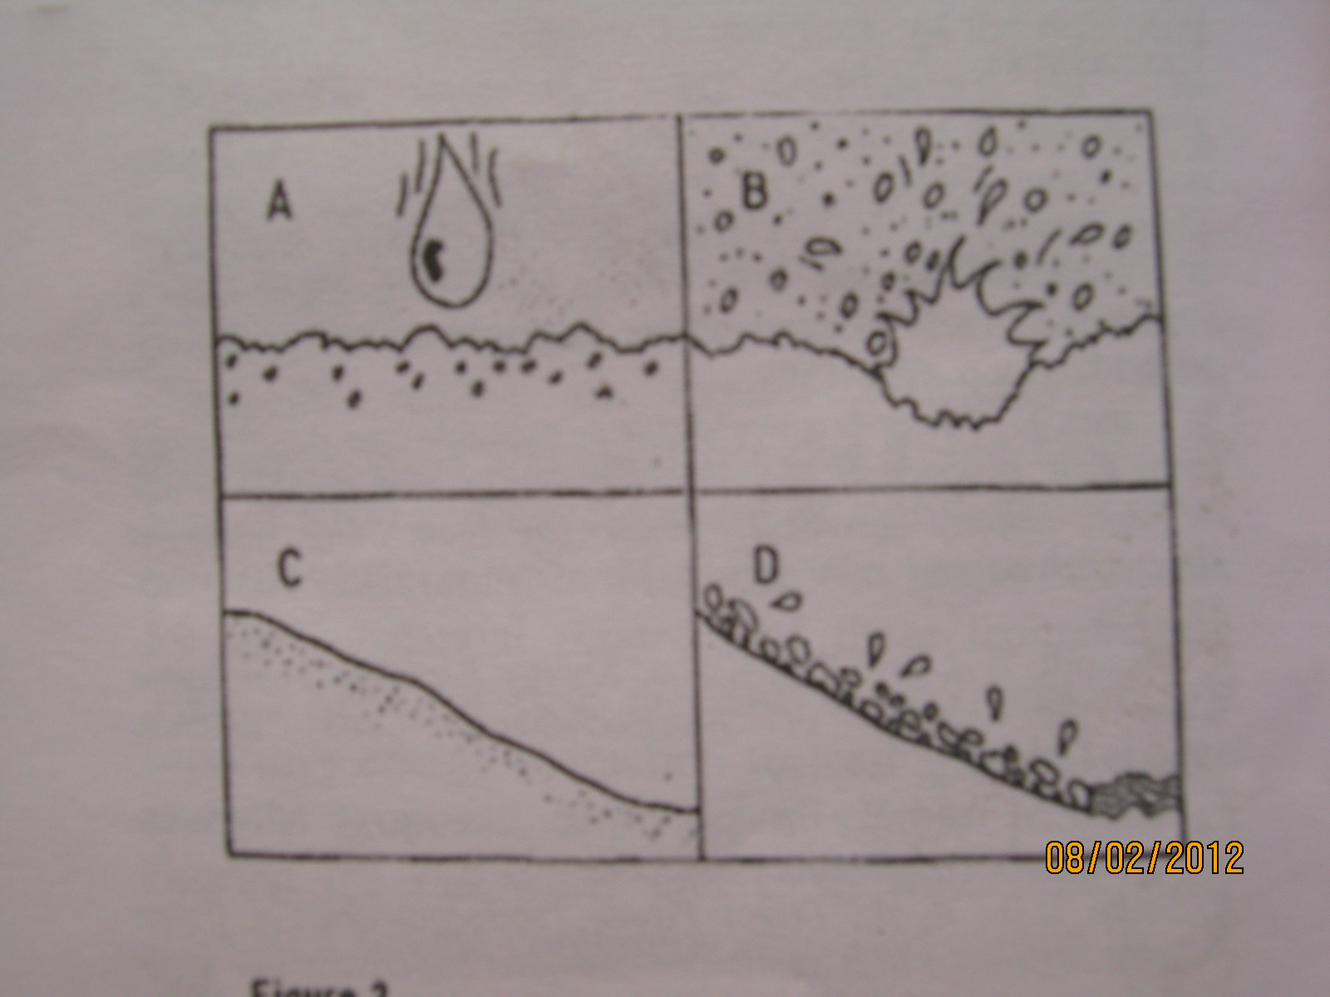

Slide 16
Changing Views on Tillage

Slide 17
Resource conservation technology
reduce the use of land damage to natural resources through agricultural production; and
increase the efficiency of resource utilization.

Slide 18
Zero Tillage/ No Tillage
Minimum Tillage
Counter Tillage
Multch Tillage
Control Traffic Farming (CTF)

Slide 19
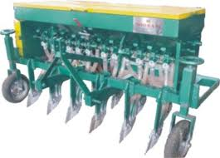
Zero tillage
dibble stick
zab seeder
Zero till drill

Slide 20
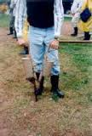
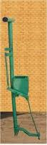
zab seeder

Slide 21
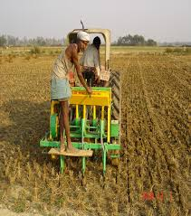
Zero till drill

Slide 22
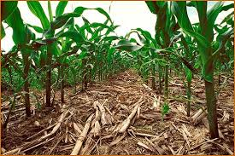
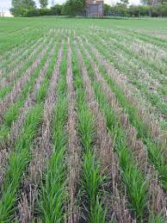
Multch Tillage

Slide 23
Minimum tillage
Minimum tillage by depth
Minimum tillage by area (strip tillage)

Slide 24
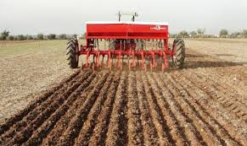
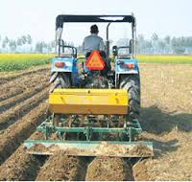

Slide 25
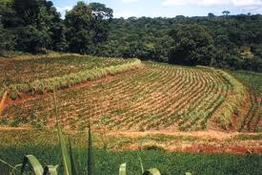
Contour tillage
The tillage is performed across the slop and along the contour and the plants are also planted along the contour

Slide 26
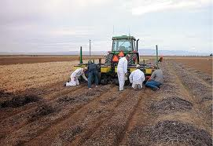
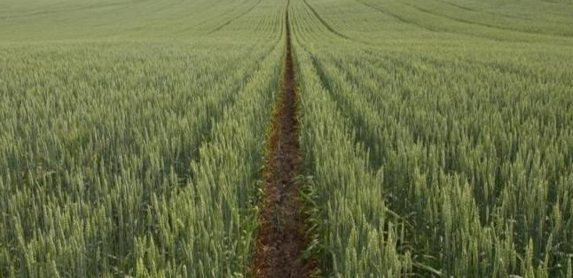
Control Traffic Farming (CTF)

Slide 27
Benefits from Zero/Minimum Tillage:
96% less erosion
66% reduction in fuel consumption
Reduced CO2 emissions
Enhanced water quality
Higher biological activity
Increased soil fertility
Enhanced production stability and yields
Lower productions costs.

Slide 28
Action during tillage
Cut the soil Brake the soil
Pulverization of soil Inversion of soil
Preparation of seed bed

Slide 29
Influence of Tillage on the soil

Slide 30
Change in bulk density
Soil strength
Water holding capacity
Change in soil structure and texture
Microbial bio-mass
Dissolved carbon
Soluble cation concentration

